Slide 1

Rectifiers
B. Sc- 5th Sem-Electronics
RR BAWA DAV College For Girls, Batala
Prof. Pankaj Kumar
HOD, Physics

Slide 2
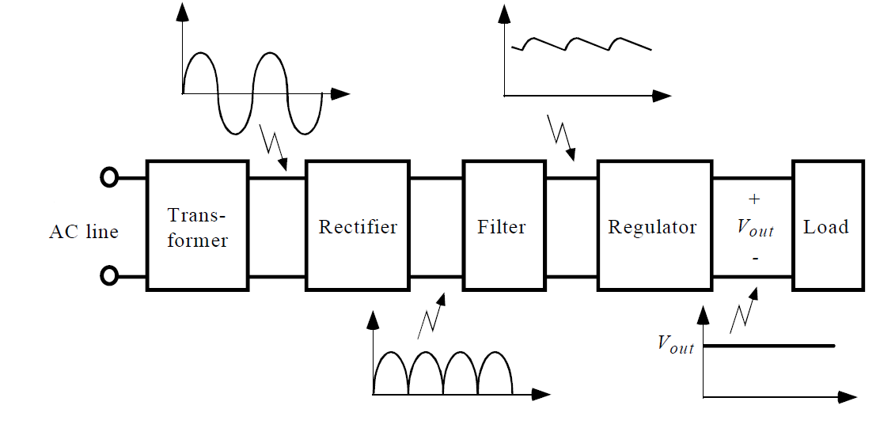
Block Diagram

Slide 3
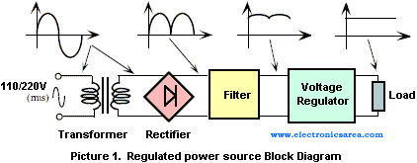
Block Diagram

Slide 4
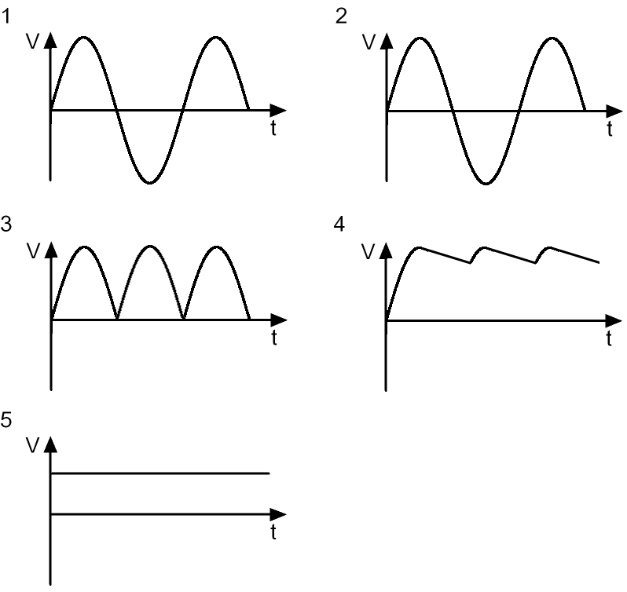
Wave forms at various points in a Regulated power supply

Slide 5
Rectification
Rectification is a process of converting the alternating quantity (voltage or current) into a corresponding direct quantity(voltage or current).
The Input to a rectifier is AC whereas its Output is unidirectional or DC.

Slide 6
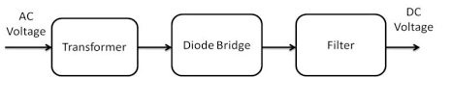
Rectifiers
Rectifier is an electronic device which is used for converting an alternating quantity (Voltage or current) into unidirectional i.e. DC quantity (Voltage or current).
Block diagram of Rectifier:

Slide 7
Need of Rectification
Every electronic circuit such as amplifiers, needs a DC power source for its operation.
This DC voltage has to be obtained from AC supply.
For this the AC supply has to be reduced Stepped down first using a Step down transformer and then converted to dc by using rectifier.

Slide 8
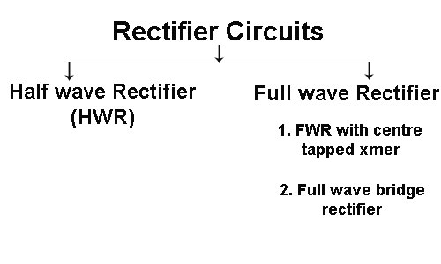
Types of Rectifier

Slide 9
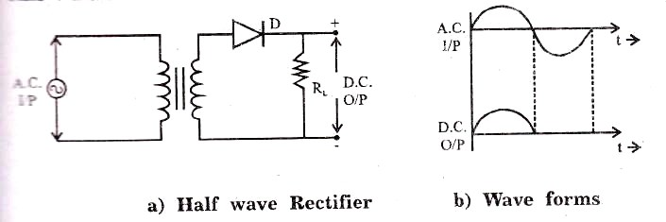
Half Wave Rectifier

Slide 10
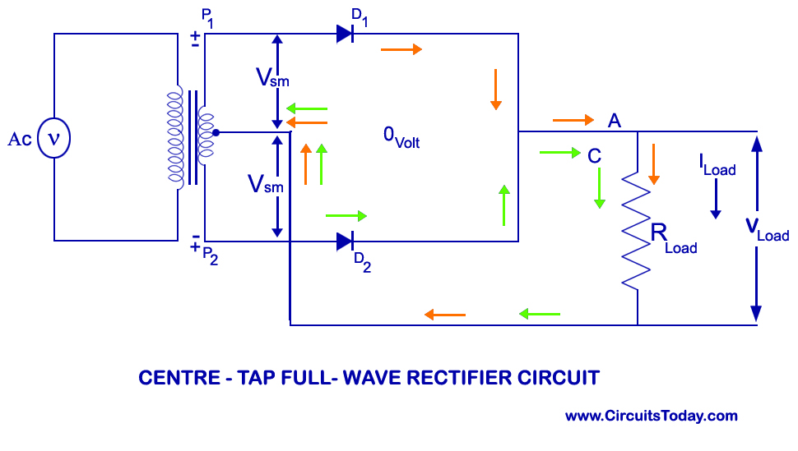
Full Wave Rectifier (Center Tapped Transformer)

Slide 11
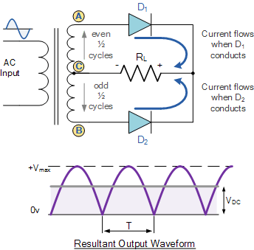

Slide 12
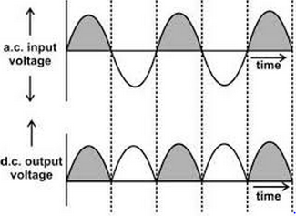

Slide 13
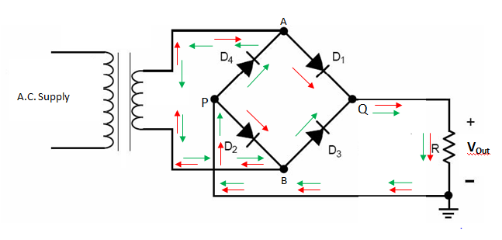
Full Wave Rectifier (Bridge)

Slide 14
For more detail contact us

Slide 15
Thanks

